Slide 1
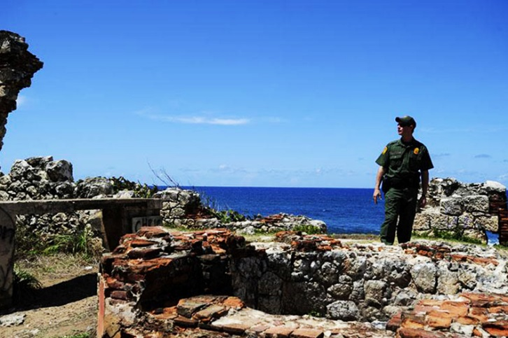
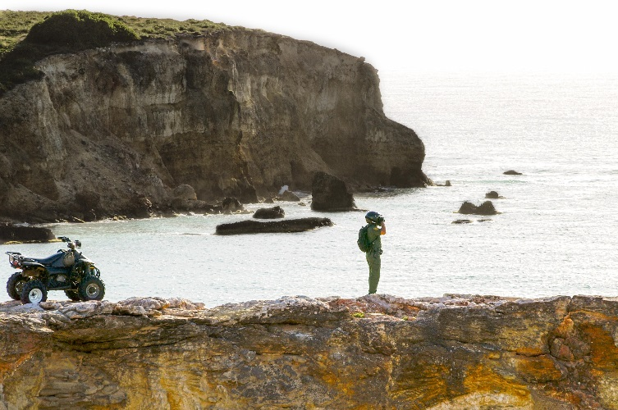
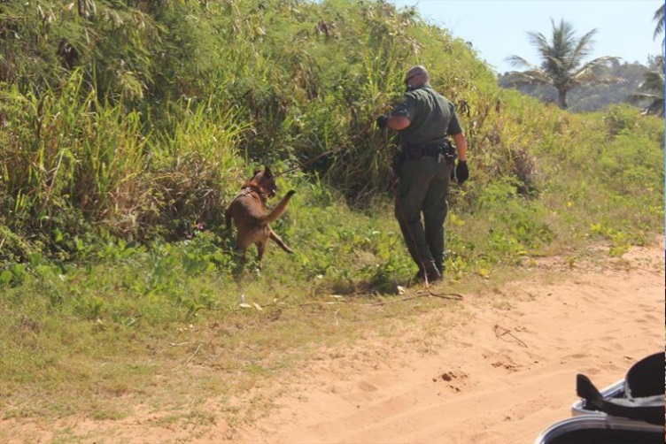
U.S. Border Patrol
Chiefs Quarterly Leadership Meeting
San Juan, P.R.
April 04-05, 2017

Slide 2
Agenda-Day 1 – Tuesday, April 4, 2017
0800-0900….Introduction – USBP Chief Vitiello and USBP Deputy Chief Provost
New Administration and Path Forward
0900-0945....287g update and path forward – LEOD Chief Hull/ Chief Chavez
0945-1000…BREAK
1000-1100…International Travel/Activities – LEOD Chief Hull
1100-1240…LUNCH
1240-1300…Transport attendees to Marin Air National Guard Base (MANG)
1300-1430...Caribbean Update* – Chief Chavez/ Chief Cerrillo at MANG
1430-1500...BREAK
1500-1600…Executive Orders – SPAD Chief Huffman
1600-1630…Day 1- Closing Remarks

Slide 3
Agenda-Day 2 – Wednesday, April 5, 2017
0800-0900…. C-2 Remarks
C-2 will conduct Ramey Sector Operational Tour
0900-0945....Wall Update – Chief Martin
0945-1000…BREAK
1000-1100…Relocation/ROB/VRP – MRO XD Hoover
1100-1300…LUNCH
1300-1600...Chief’s Forum
1600-1630…Conference Closing Remarks

